Slide 1
Module 2
Advance Database management System
BCAE0001

Slide 2
Syllabus
Concurrency Control Techniques:
Two Phase Locking Techniques for Concurrency Control,
Concurrency Control Based on Timestamp Ordering.
Deadlock:
Deadlock Handling,
Deadlock Prevention,
Deadlock Detection and
Deadlock Recovery Techniques.
Recovery System:
Failure Classification,
Storage Structure,
Data Access.

Slide 3
Dead Lock in DBMS
A system is in dead lock state if there exists a set of transactions such that every transaction in the set is waiting for another transaction in the state.
T2
T3
T4
T5
T1

Slide 4
Dead Lock in DBMS
If there exists a set of waiting transaction T0, T1, T2, T3,……Tn-1.
Such that T0 -> T1-> T2-> T3 -> ……->Tn-1 -> T0
So no transaction can progress in this situation.

Slide 5
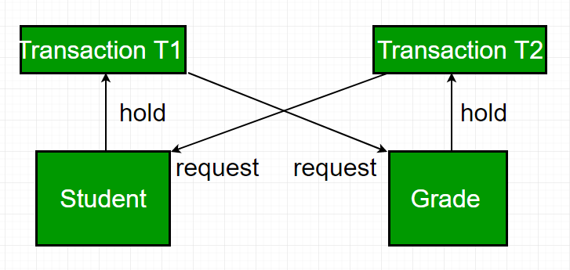

Slide 6
To occur Deadlock in the System
Hold & Wait:
Transaction can hold the resources they have already acquired while waiting for additional resources.

Slide 7
To occur Deadlock in the System
No Preemption:
Resources cannot be forcibly removed from transactions.
Resources are explicitly released by transaction (e.g. unlock).

Slide 8
To occur Deadlock in the System
Mutual Exclusion:
Transaction can claim exclusive access to the resources they acquire.

Slide 9
To occur Deadlock in the System
Circular Wait:
A circular chain of transactions exists such that each transaction holds (at least) one resource being requested by the next process in the chain.

Slide 10
Why to handle deadlock ?
System must have proper methods to deal with deadlocks, otherwise..
In Real Time System it may lead to disaster.
Will reduce resource utilization and increase inefficiency.

Slide 11
Principles to deal with Dead Lock
Prevention: which ensure that system will never enter a dead lock state.
Detection & Recovery: Allow system to enter dead lock, then try to recover.

Slide 12
Principles to deal with Dead Lock
Both methods may result in transaction rollback.
Probability that the system would enter a deadlock state is
relatively high: - use Prevention
Low: - use Detection and Recovery

Slide 13
Dead Lock Prevention
Two approaches for Dead Lock Prevention:-
No Cyclic wait
No Hold & wait

Slide 14
Dead Lock Prevention- No Hold & Wait
To ensure No Hold & Wait ---
Each transaction locks all the data item, before it begin execution
Example: Conservative 2PL

Slide 15
Disadvantages of No Hold & Wait
Hard to predict, before the transaction begins, what data items need to be locked;
(2) Data-item utilization may be very low, since many of the data items may be locked but unused for a long time.

Slide 16
Dead Lock Prevention - No Cyclic Wait
To ensure No Cyclic Wait ---
Impose an ordering of all data item,
Transaction locks data item only in the sequence consistent with ordering
Example: Tree Protocol

Slide 17
Let two data items A and B having order A ->B
Let Ti and Tj wants to access A and B respectively, but whoever gets access of A first, will be granted its required resource,……….hence no cyclic wait
Ti
A(1)
Tj
B(2)

Slide 18
Disadvantages of No Cyclic Wait
Difficult to order all the data item.
Ordering of data item may be a time consuming process.

Slide 19
Dead Lock Prevention Approaches-Classification
Wait-Die: (Non Preemptive)
Wound-Wait:(Preemptive)
Lock time-out

Slide 20
Wait-Die: (Non Preemptive)
When transaction Ti requests a data item currently held by Tj ,
Ti is allowed to wait only if it has a timestamp smaller than that of Tj (that is, Ti is older than Tj ).
Otherwise, Ti is rolled back (dies).

Slide 21
Wait-Die: (Non Preemptive)
If TS(Ti) < TS(Tj), then Ti must wait (Ti is senior)
Ti
Tj
requesting
having
Q

Slide 22
Wait-Die: (Non Preemptive)
If TS(Ti) > TS(Tj), then Ti rollback (die)
Ti
Tj
requesting
having
Q
In this case whenever a transaction rollbacks.
It comes in system again with previous time stamp value

Slide 23
Wound-Wait: (Preemptive)
It is a counterpart to the wait–die scheme.
When transaction Ti requests a data item currently held by Tj ,
Ti is allowed to wait only if it has a timestamp larger than that of Tj (that is, Ti is younger than Tj ).
Otherwise, Tj is rolled back (Tj is wounded by Ti).

Slide 24
Wound-Wait: (Preemptive)
If TS(Ti) > TS(Tj), then Ti must wait (Ti is younger)
Ti
Tj
requesting
having
Q

Slide 25
Wound-Wait: (Preemptive)
If TS(Ti) < TS(Tj), then Tj rollback (die)
Ti
Tj
requesting
having
Q
In this case whenever a transaction rollbacks.
It comes in system again with previous time stamp value

Slide 26
There may be fewer rollbacks in the wound–wait scheme in comparison to wait-die scheme
The major problem with both of these schemes is that unnecessary rollbacks may occur.
wait-die wound-wait Ti is younger than Tj Ti dies Ti waits Ti is older than Tj Ti waits Tj aborts

Slide 27
Lock Time-Out
Let lock time out = 5 minutes, then Ti will wait for 5 minutes for resource (Q), if not granted then will rollback after 5 minutes.
Ti
Tj
requesting
having
Q

Slide 28
Disadvantages of Lock Time-Out
it is hard to decide how long a transaction must wait before timing out.
Too long a wait results in unnecessary delays once a deadlock has occurred.
Too short a wait results in transaction rollback even when there is no deadlock, leading to wasted resources.
Starvation is also a possibility with this scheme.
Hence, the timeout-based scheme has limited applicability.

Slide 29
Disadvantages of Lock Time-Out
it is hard to decide how long a transaction must wait before timing out.
Too long a wait results in unnecessary delays once a deadlock has occurred.
Too short a wait results in transaction rollback even when there is no deadlock, leading to wasted resources.
Starvation is also a possibility with this scheme.
Hence, the timeout-based scheme has limited applicability.

Slide 30
Disadvantages of Lock Time-Out
it is hard to decide how long a transaction must wait before timing out.
Too long a wait results in unnecessary delays once a deadlock has occurred.
Too short a wait results in transaction rollback even when there is no deadlock, leading to wasted resources.
Starvation is also a possibility with this scheme.
Hence, the timeout-based scheme has limited applicability.

Slide 31
Disadvantages of Lock Time-Out
it is hard to decide how long a transaction must wait before timing out.
Too long a wait results in unnecessary delays once a deadlock has occurred.
Too short a wait results in transaction rollback even when there is no deadlock, leading to wasted resources.
Starvation is also a possibility with this scheme.
Hence, the timeout-based scheme has limited applicability.

Slide 32
Deadlock Detection & Recovery
An algorithm that examines the state of the system is invoked periodically to determine whether a deadlock has occurred.
If one has, then the system must attempt to recover from the deadlock.

Slide 33
Deadlock Detection & Recovery
To do so, the system must:
maintain information about the
current allocation of data items to transactions,
Any outstanding data item requests.

Slide 34
Deadlock Detection & Recovery
To do so, the system must:
Maintain information about the current allocation of data items to transactions, as well as any outstanding data item requests.
Provide an algorithm that uses this information to determine whether the system has entered a deadlock state.
Recover from the deadlock when the detection algorithm determines that a deadlock exists.

Slide 35
Deadlock Detection & Recovery
To do so, the system must:
Maintain information about the current allocation of data items to transactions, as well as any outstanding data item requests.
Provide an algorithm that uses this information to determine whether the system has entered a deadlock state.
Recover from the deadlock when the detection algorithm determines that a deadlock exists.

Slide 36
Deadlock Detection
When a transaction waits indefinitely to obtain a lock, then the DBMS should detect whether the transaction is involved in a deadlock or not.
The lock manager maintains a Wait for Graph to detect the deadlock cycle in the database.

Slide 37
Wait for Graph
In this method, a graph is created based on the transaction and their lock.
If the created graph has a cycle or closed loop, then there is a deadlock.
The wait for the graph is maintained by the system for every transaction which is waiting for some data held by the others.

Slide 38
Wait for Graph
When transaction Ti requests a data item currently being held by transaction Tj ,
Then the edge Ti → Tj is inserted in the wait-for graph.
This edge is removed only when transaction Tj is no longer holding a data item needed by transaction Ti.

Slide 39
Wait for Graph
This graph consists of a pair G =(V, E),
V is a set of vertices
E is a set of edges.
The set of vertices consists of all the transactions in the system.
Each element in the set E of edges is an ordered pair Ti → Tj .
If Ti → Tj is in E, then there is a directed edge from transaction Ti to Tj ,
Implying that transaction Ti is waiting for transaction Tj to release a data item that it needs.

Slide 40
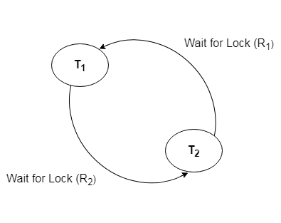

Slide 41
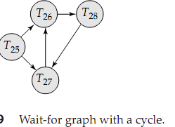
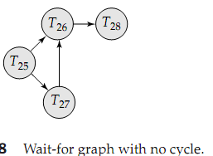

Slide 42
Recovery from Deadlock
When a detection algorithm determines that a deadlock exists, the system must recover from the deadlock.
Three actions need to be taken:
Selection of a victim
Rollback
Starvation

Slide 43
1. Selection of a victim
Given a set of deadlocked transactions, we must determine which transaction (or transactions) to roll back to break the deadlock.
We should roll back those transactions that will incur the minimum cost.
Unfortunately, the term minimum cost is not a precise one.

Slide 44
1. Selection of a victim
Many factors may determine the cost of a rollback, including
How long the transaction has computed, and how much longer the transaction will compute before it completes its designated task.
How many data items the transaction has used.
How many more data items the transaction needs for it to complete.
How many transactions will be involved in the rollback.

Slide 45
2. Rollback
Once we have decided that a particular transaction must be rolled back.
We must determine how far this transaction should be rolled back.
Total rollback: Abort the transaction and then restart it.
Partial Rollback : Roll back the transaction only as far as necessary to break the deadlock.
Requires the system to maintain additional information about the state of all the running transactions.
The sequence of lock requests/grants and
Updates performed by the transaction

Slide 46
2. Rollback
The deadlock detection mechanism should decide which locks the selected transaction needs to release in order to break the deadlock.
The selected transaction must be rolled back to the point where it obtained the first of these locks, undoing all actions it took after that point.

Slide 47
3. Starvation
In a system where the selection of victims is based primarily on cost factors, it may happen that the same transaction is always picked as a victim.
As a result, this transaction never completes its designated task, thus there is starvation.
We must ensure that transaction can be picked as a victim only a (small) finite number of times.
The most common solution is to include the number of rollbacks in the cost factor.

Slide 48
Detection and recovery scheme requires overhead that includes :
Detection
The cost of maintaining the necessary information
The run-time cost of of executing the detection algorithm
Recovery
The potential losses inherent in recovery from a dead-lock.

